Slide 1
ZF LiftLoop
An In-House Carpooling Platform for Sustainable Commuting
By Zodiac Falcons

Slide 2
Problem Statement - ZF LiftLoop
Enhancing Employee Commuting Experience Through a Sustainable and Collaborative Carpooling Platform
Context: ZF employees face challenges related to commuting, including rising transportation costs, limited parking availability, and environmental concerns.
Current transportation solutions do not fully address these challenges in a secure, efficient, and collaborative manner.
Additionally, ZF as an organization is committed to reducing its carbon footprint and fostering employee collaboration but lacks a tailored in-house carpooling platform to achieve these goals.

Slide 3
Key Challenges:
Cost and Convenience:
Employees spend significant amounts on daily commutes, leading to financial strain.
Dependence on private or external transportation results in inefficiencies and lack of control.
Environmental Impact:
The high volume of single-occupancy vehicles contributes to increased carbon emissions.
Limited organizational efforts in optimizing transportation for sustainability.
Lack of Employee-Centric Solutions:
Existing carpooling apps do not cater specifically to ZF employees, leading to trust and safety concerns.
Employees lack a platform that encourages collaboration and aligns with ZF’s sustainability initiatives.

Slide 4
Product Overview
Objective:
To create a collaborative and sustainable commuting ecosystem which
• Provide an in-house carpooling platform exclusively for ZF employees.
• Optimize the commuting experience by connecting employees travelling on similar routes.
• Support ZF’s commitment to sustainability by reducing single-occupancy vehicle usage.
• Foster employee interaction and collaboration through shared rides.
Key Highlights:
Purpose-Driven Innovation: Simplifies commuting, reduces costs, and minimizes carbon footprint.
In-House Collaboration: Trusted and secure platform exclusive to employees.

Slide 5
Product Goals
Sustainability:
Reduce ZF's overall carbon footprint by minimizing single-occupancy vehicle use.
Promote eco-friendly commuting practices among employees.
Employee Welfare:
Provide a secure, reliable, and cost-effective commuting option tailored for ZF employees.
Enhance employee satisfaction by addressing their commuting challenges.
Operational Excellence:
Deliver a seamless and user-friendly platform that ensures trust and convenience.
Enable real-time ride sharing with a focus on accuracy, safety, and efficiency.
Community Building:
Foster collaboration among employees by creating shared commuting opportunities.
Strengthen ZF’s internal community culture through teamwork and interaction.
Corporate Branding:
Reinforce ZF's commitment to innovation and sustainability through in-house initiatives.
Position ZF as a forward-thinking organization that values environmental and employee well-being.

Slide 6
Platform Features
1. User Roles:
- Admin: Manages activity and posts.
- Ride Provider: Shares ride details.
- Passenger: Searches and books rides.
2. Rides Listing:
- Displays rides with details like route, timing, and seat availability.
- Easy-to-use search functionality.
3. Ride Posting Details:
- Key information: Vehicle type, route, time, and seats available.
- Option to post rides for specific durations.

Slide 7
Admin Features
Right to delete inappropriate or expired ride posts.
Monitors and maintains platform integrity.
Dashboard (Future Enhancement):
Total rides offered or taken.
Carbon footprint reduced.
Total kilometers traveled collaboratively.

Slide 8
Unique Value Proposition
Exclusive Employee Benefits: Offers ZF employees a secure, reliable, and eco-friendly commuting solution.
Corporate Branding: Positions ZF as a forward-thinking, sustainable organization that prioritizes employee welfare.
Enhanced Collaboration: Promotes in-house collaboration and builds a stronger employee community.
Market Analysis
Niche Audience: Unlike competitors, ZF LiftLoop is exclusively designed for ZF employees, ensuring a trusted and safe environment.
Safety-First Approach: ZF LiftLoop achieves top ratings in safety due to in-house operations and user verification.
Cost Advantage: By eliminating external fees, ZF LiftLoop offers unparalleled cost efficiency.
Sustainability Impact: ZF LiftLoop supports corporate sustainability goals by reducing the organization’s carbon footprint.

Slide 9
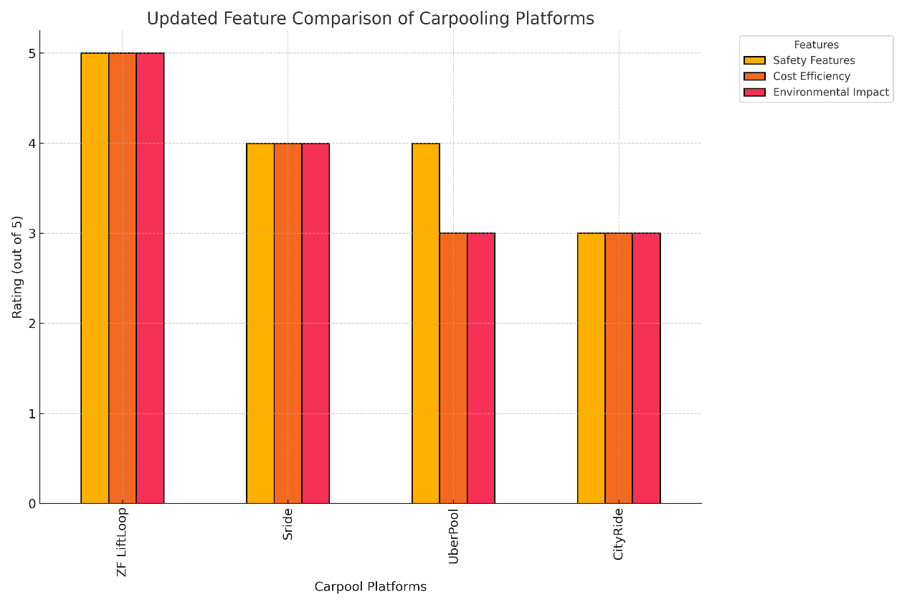
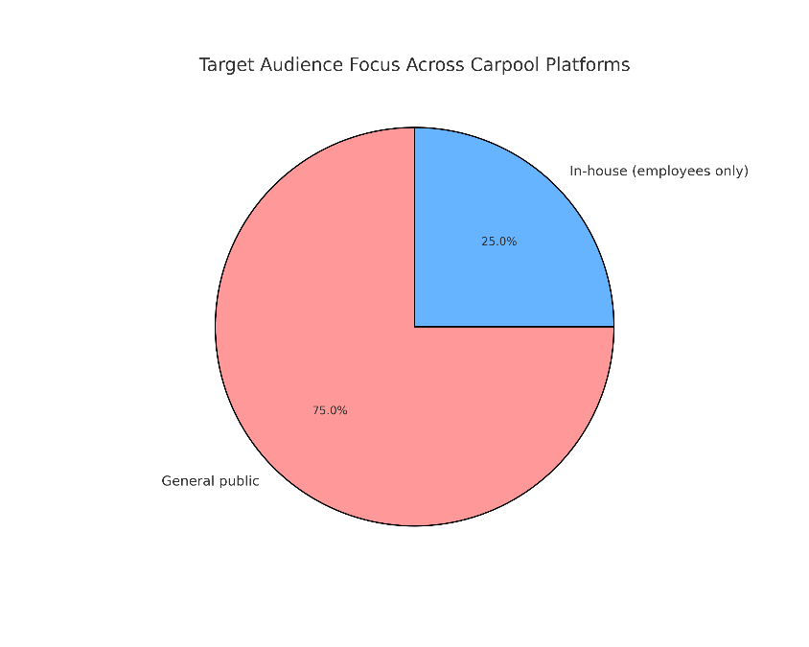

Slide 10
Product Roadmap
Phase 1: MVP Development (2 Days – Hackathon) - N
User authentication and verification.
Ride posting and booking functionality.
Basic admin dashboard for ride management.
Phase 2: Advanced Features (N + 10 days)
Notifications for ride updates and booking confirmations.
Ride filtering (e.g., timing, route, vehicle type).
Analytics dashboard to track platform usage and sustainability metrics.
Phase 3: Engagement and Scalability (N + 30 days)
Introduce gamification features (e.g., eco-badges for regular users).
Enable integration with corporate portals for business unit tracking.
Optimize performance for scalability.
Phase 4: Future Enhancements (30 days)
Add a mobile app for better accessibility.
AI-driven ride matching and recommendations.
Enable dynamic pricing based on demand (optional).

Slide 11
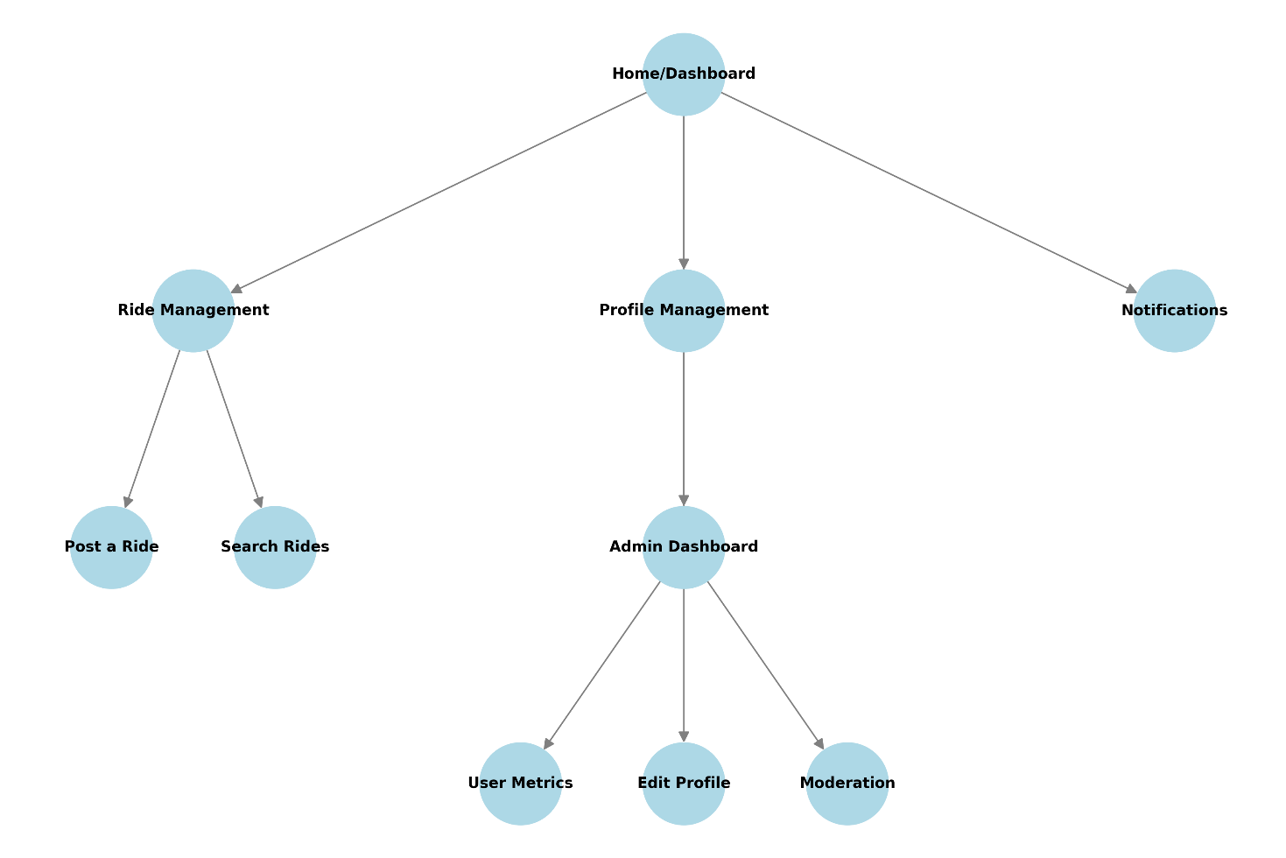
Information Architecture (site map)

Slide 12
LIVE DEMO

Slide 13
Cost vs. Benefit Comparison
Annual Costs:
Development (Year 1): $Y
Operational Costs: $Z
Annual Benefits:
Financial Savings: $A
Sustainability and Reputation Value: $B
Productivity Gains: $C
Net Annual Benefit: ($A + $B + $C) - ($Y + $Z)

Slide 14
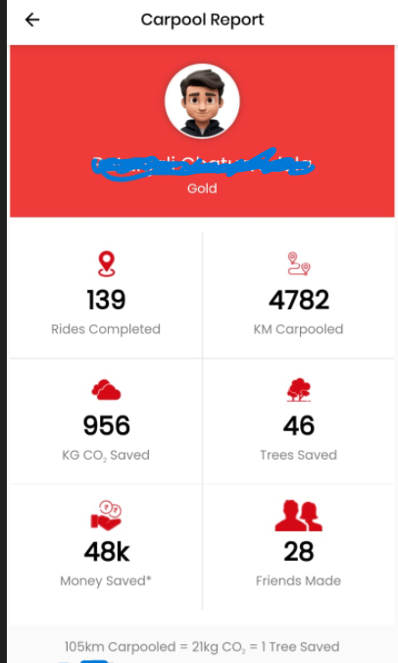
• Key Metrics for the Individual:
Rides Completed: 139 rides.
Distance Carpooled: 4,782 kilometers.
CO₂ Saved: 956 kilograms of carbon dioxide reduced.
Trees Saved: Equivalent to saving 46 trees.
Money Saved: ₹48,000 saved.
Friends Made: 28 new connections formed.
• Environmental Impact:
105 km carpooled saves 21 kg of CO₂, equivalent to saving 1 tree.
• Recognition:
The individual has achieved a Gold badge, indicating consistent and significant contributions to carpooling.

Slide 15
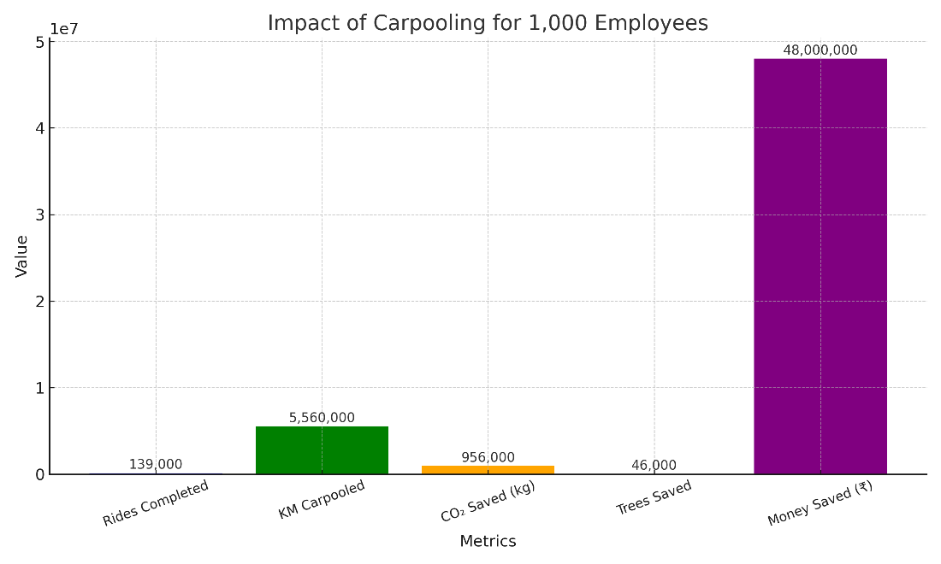
Summary for 1,000 Members per year :
Could have completed 139,000 rides
5,560,000 km carpooled
956,000 kg CO₂ saved
46,000 trees saved
₹ 4,80,00,000 saved

Slide 16



